Slide 1
The Uniform
As prescribed per league

Slide 2
There are two classifications of uniforms…
The Plate Umpire
The Base Referee

Slide 3
Plate Umpire
The plate umpire’s uniform is comprised of these basic elements…
Appropriate color, sleeve length, style, and patch shirt
Matching color undershirt
Charcoal grey or Heather grey pants
Black (gloss or matte) two inch belt
Ball bag matching the color of the pants
Plate shoes (steel toe)
Shin guards
Chest Protector
Face mask or hockey style helmet
Ball and Strike Counter and plate brush
Matching color hat with appropriate patch

Slide 4
Base Referee
The Base Referee’s uniform is very similar to the umpire’s…
Appropriate color, sleeve length, style, and patch shirt
Matching color undershirt
Charcoal grey or Heather grey pants
Black (gloss or matte) two inch belt
Ball and Strike Counter and plate brush
Matching color hat with appropriate patch
Sturdy black running shoes or baseball cleats

Slide 5
Optional Items
The following items may be used and some are commended…
Sunglasses
Sweatband
Matching Jacket (wind breaker or cold weather)

Slide 6
Items BOTH Officials should have…
These are items to have on the field with you for game management…
Note pad and pen
To record any misconduct, time outs, warnings, ect.
Watch
To ensure the game time is correct… cant always relay on the clock to work.
Water Source
Stay hydrated, its hot out their and we need to function at prime capability.

Slide 7
Uniform Examples

Slide 8
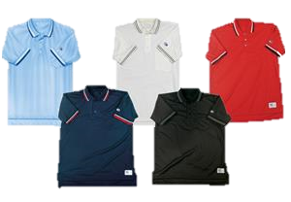
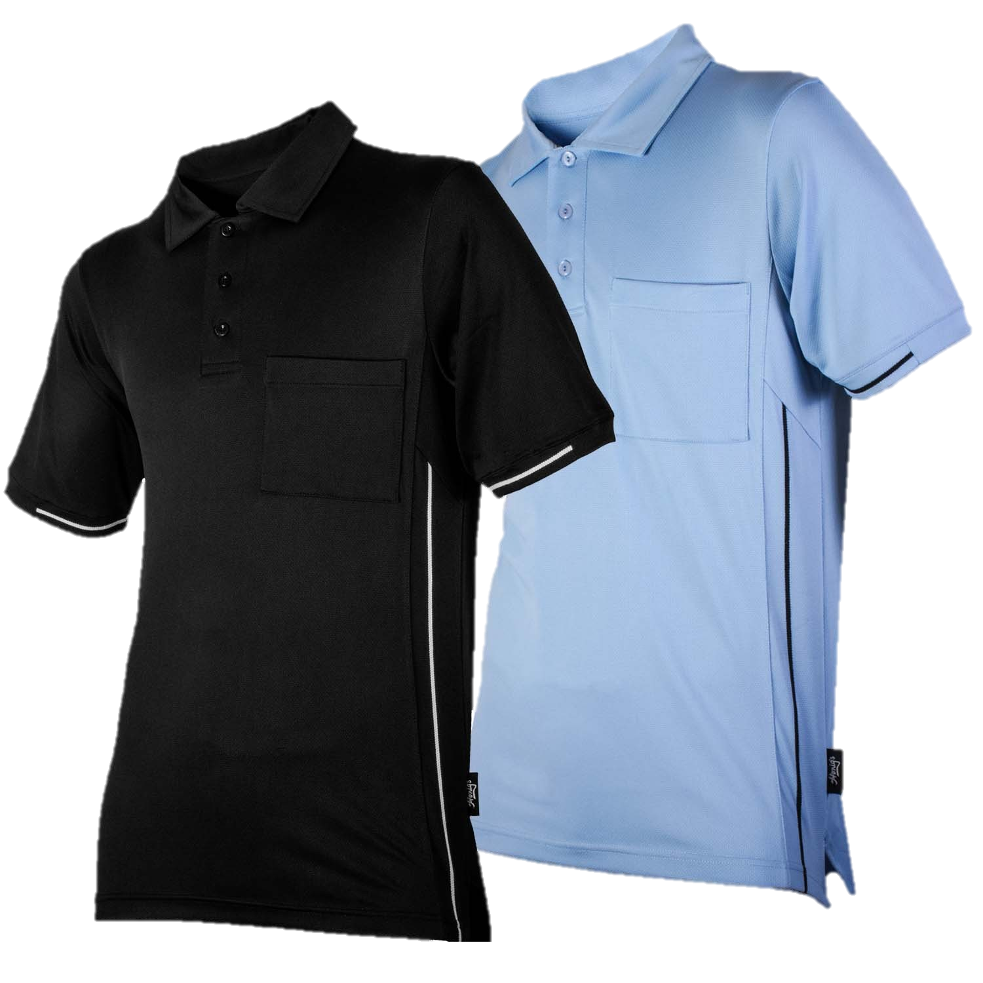
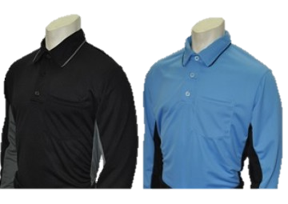
The Shirt…
For Recreation Ball these are the shirt options available to wear. These also have long sleeve options. No patch is needed for Rec. however, if you are selected for tournament play under the Dixie Rule Set you will need a Dixie Patch for those games. The undershirt should match the color of the shirt being worn.

Slide 9
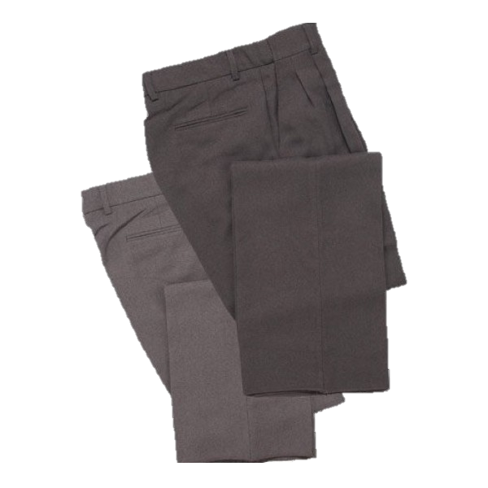
The Pants…
As baseball officials we only wear PANTS, we do not wear shorts on the field. These pants are seen to the right in Heather or Charcoal grey. There are three options when buying pants… Plate, Base, and Combo. Your pants should fit properly allowing for easy movement and frequent bending at the waist and knees. The hem of the pants should not drag the ground and should not rise above the top of the ankle of the shoe worn. Your pants need to be clean and professionally presentable for each game.

Slide 10
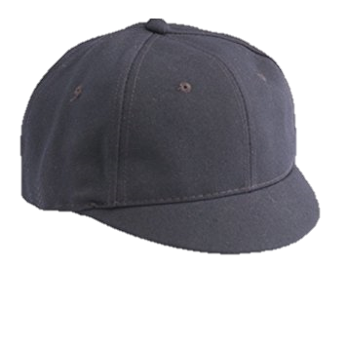
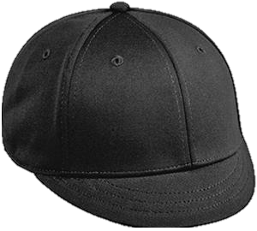
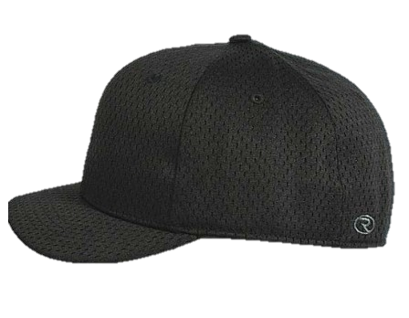
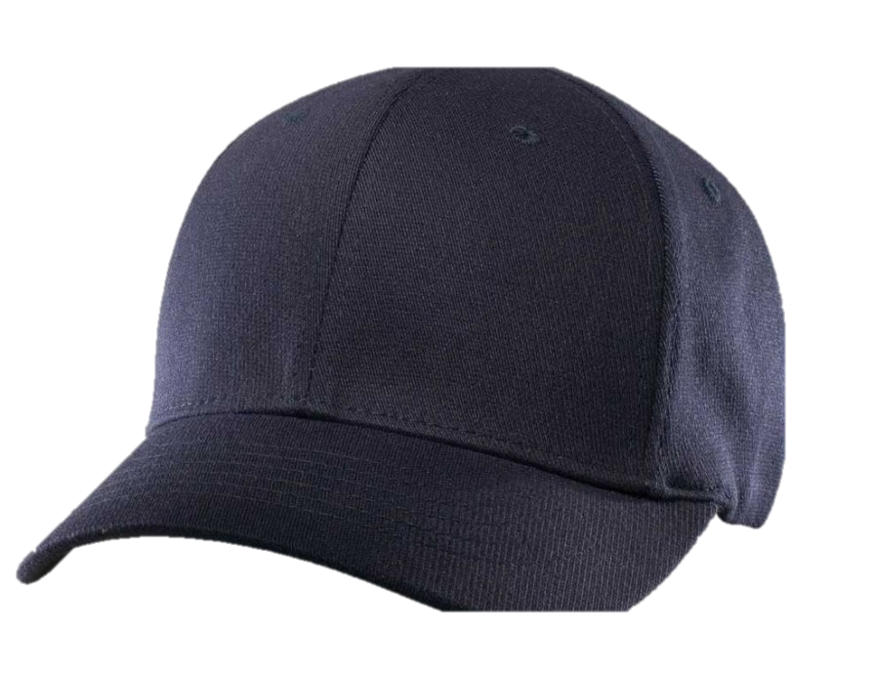
The Hat…
For Rec Ball we wear hats without patches. The color of the hat is either navy blue or black, this will be determined by the color shirt you are wearing. A navy blue or powder blue shirt is worn with a navy blue hat. All other color shirts are worn with a black hat. The style hat depends on the person wearing it. The beanie or short bill hate is for Plate umpire use with the facemask. The base referee can wear a six or eight stich hat.

Slide 11
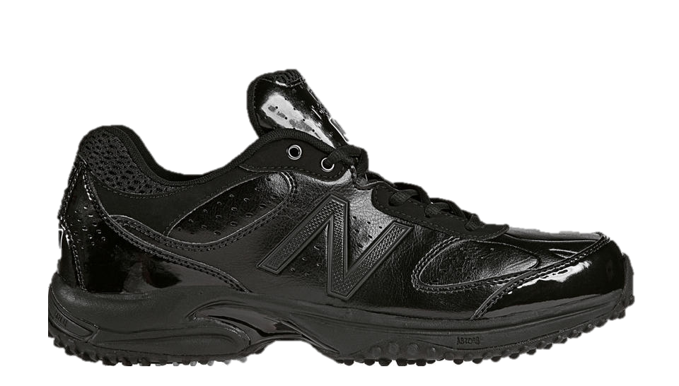
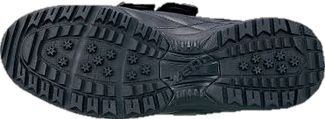
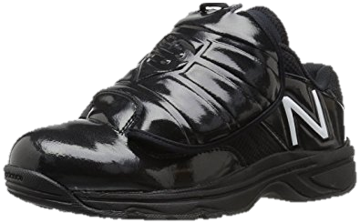
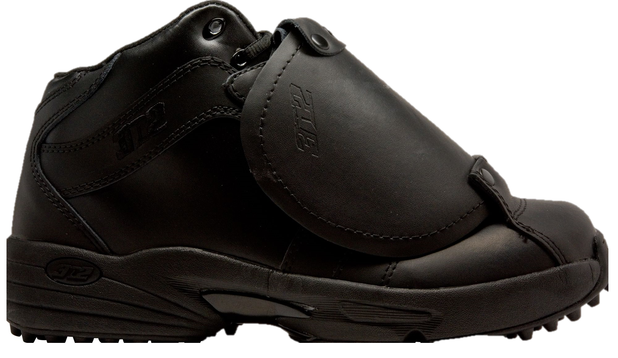
The Shoes…
There are so many different options for shoes. Plate umpires will wear plate shoes, equip with steel toes and a protective plate over the top of the foot. The base referee can wear any sturdy running shoe or baseball cleat as long as it is black and in good condition. Shoes should be cleaned and shined (if wearing a gloss finish shoe) when arriving at the field. Professional appearance is what every umpire should strive for.

Slide 12
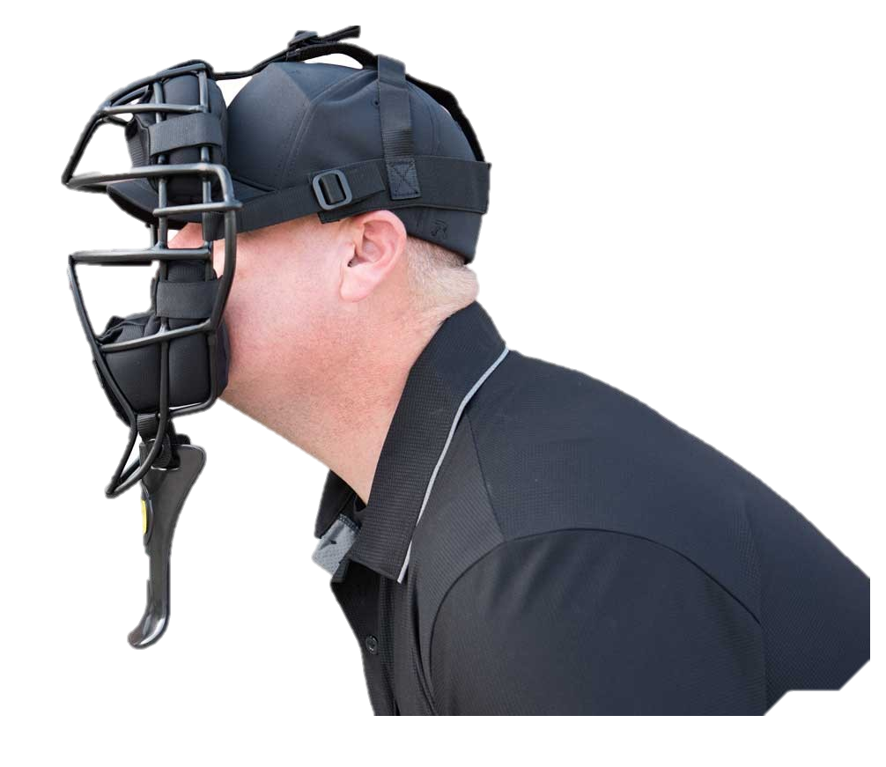
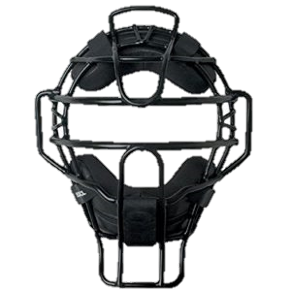
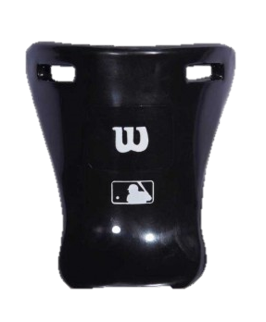
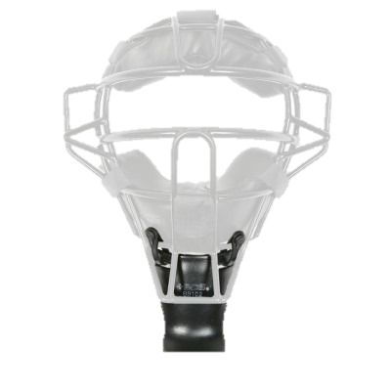
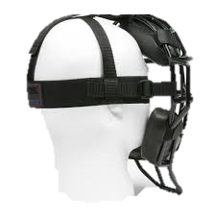
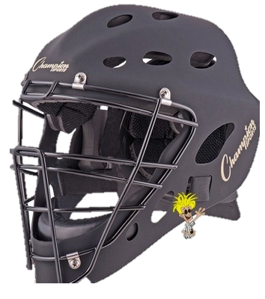
Protective Gear…
Face Mask
There are a TON of styles and brands of face masks out there for the umpire. As show there is the traditional and hockey style mask. Both are acceptable. It is required that umpires use a throat guard with any mask that does not have extended throat protecting. Also ensure the padding and head harness of the mast your choose fits you correctly.

Slide 13
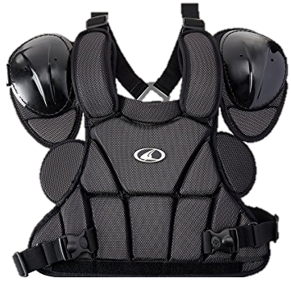
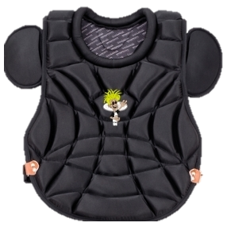
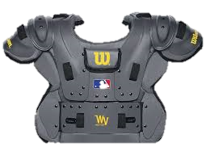
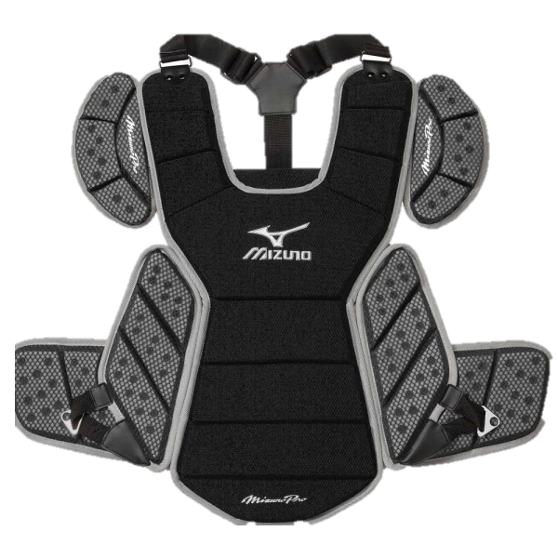
Protective Gear…
Chest Protector
There are many different style and protection level chest protectors. Here are a few. It is important to wear one that fits your properly and will provide the level of protection you will need for the level of play. This piece of gear is worn over the undershirt and under the actual shirt.

Slide 14
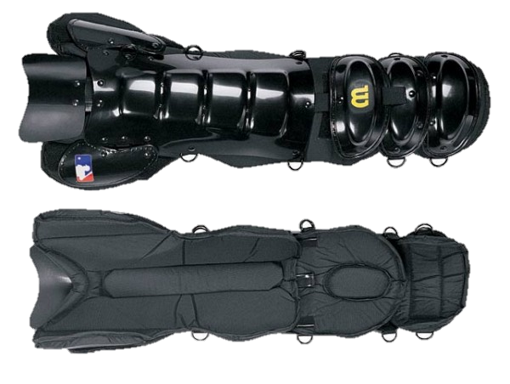
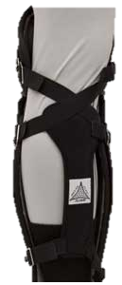
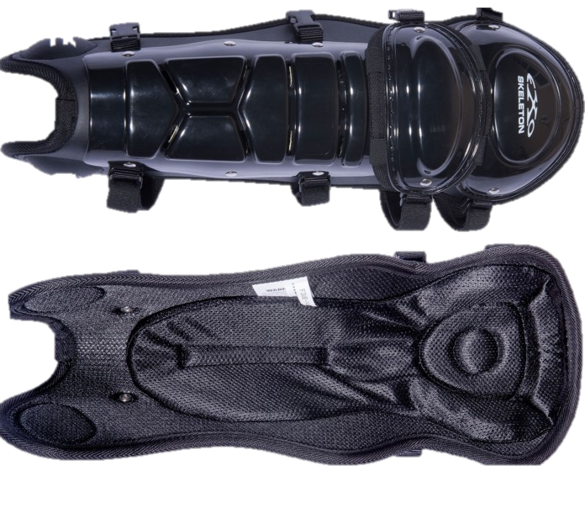
Protective Gear…
Shin Guards
Shin Guards like all the other gear comes in many styles and levels of protection. Find the one that fits you best, remember behind the plate you will be bending at the knee a lot and will have to run down a play every now and again. The shin guard is worn under the pant leg and should be secured snuggly so they do not come off during play.

Slide 15
Protective Gear…
Other
Males are required to wear a protective cup behind the plate, the base official has the option of wearing one or not.

Slide 16
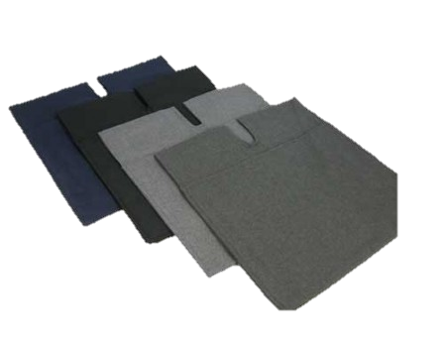
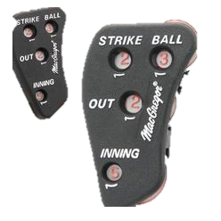
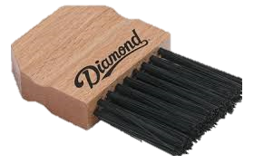
Accessories…
Ball Bag, Plate Brush, and Ball/Strike Counter
The ball bag will match the color of the pants and will not be the plastic material bag. All ball bags will be the cloth material and worn on the dominate side or both sides if two are worn. The counter comes in many variations, ensure it has at least balls, strikes, and outs on it. The plate brush comes in several variations, any style is acceptable.

Slide 17
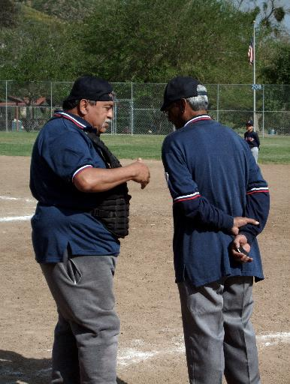
Present a PROFESSIONAL appearance at ALL TIMES!!! Don’t be like these gentlemen.

